Slide 1
Requirement Engineering

Slide 2
Class Rules
All assignments have to be submitted on time
No cheating
WhatsApp Group
Cheating = no grade
Late = point deduction
Information and coordination of classes

Slide 3
Class Marking
Assignments
Individual and Team-based
Mid-Test and Final Test
Final Project
Prototype/System based on RE
Requirement Specification

Slide 4
Requirement Engineering Materials
Basic of Requirement Engineering
Requirement Elicitation
Requirement Analysis and Prioritization
Requirement Specification
Requirement Validation

Slide 5
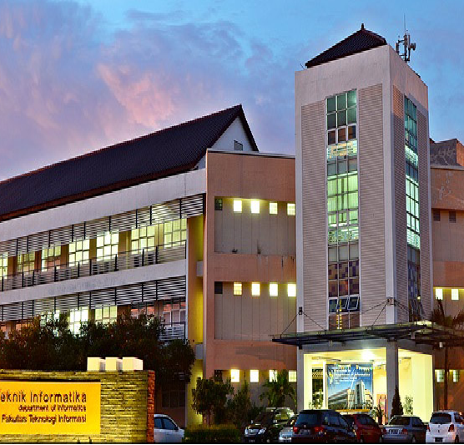
Introduction to Requirement Engineering
Requirement Engineering
Requirement Engineering Lecturer’s Team

Slide 6
Illustration
Please, build me a swing …

Slide 7
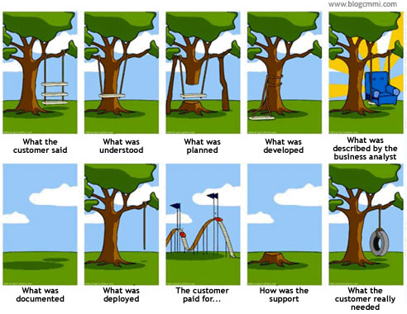

Slide 8
What is ...
REQUIREMENT ???

Slide 9
Requirement Definition
The description of how the system should behave.
System properties or attributes, characteristics, and quality of the system so that it can provide value or be useful to its users.
Requirement Specification:
A set of documented requirements of a particular product or service that must exist or be performed or made.

Slide 10
Definition of Engineering
A series of structured activities (processes) to manage a series of resources so as to form a system that has value for its users.
Refer to best practice.
Notes:
- Best Practice: langkah penyelesaian masalah yang dibangun dari serangkaian pengalaman di masa lalu terkait atas permasalahan yang sama.

Slide 11

So, what is ...
Requirement Engineering....

Slide 12
Definition of Requirement Engineering
Requirement Engineering
Includes activities of investigating, searching, or identifying system requirement specifications, and communicating them to customers and developers both orally and in writing.
System requirements should describe:
External requirements→ user interests
System functionality and limitations
Internal requirements→ developer interests
Covers engineering aspects, such as convenience, portability, scalability, etc.

Slide 13
Why do we need Requirement Engineering?
All software has specifications
The problem starts with the requirements specification
40% - 60% of errors in software development projects that arise at a later stage, starting from mistakes made at the requirements specification stage. (Darvis & Leffingwell)

Slide 15
RE's fault investigation results
Bell Labs and IBM studies
80% of defects were collected during the requirement phase.
Improvements to the requirements definition process can reduce the amount of testing and rework required
These losses do not include losses for end users – who are forced to operate software on a daily basis [Testing Technique Newsletter]
U.S. Air Force projects
36% of defects are due to mistranslation of needsOnly 9% of these defects can be resolved (and even during the requirement phase). [Sheldon 92]
Voyager and Galileo spacecraft
Out of a total of 197 PL errors found during integration & testing, only 3 of them were programming errors. – the rest?? Due to a requirement error. [Lutz 93]

Slide 16
RE's fault investigation results (2)
Application Specific Integrated Circuits (ASICs)
>1/2 error on initial build of circuit. Most of the errors related to requirements errors
[UK Health and Safety] Executive
Specification 44.1%
Design and Implementation 14.7%
Installation and Commisioning 5.9%
Operation and maintenance 14.7%
Changes after commisioning 20.6%

Slide 17
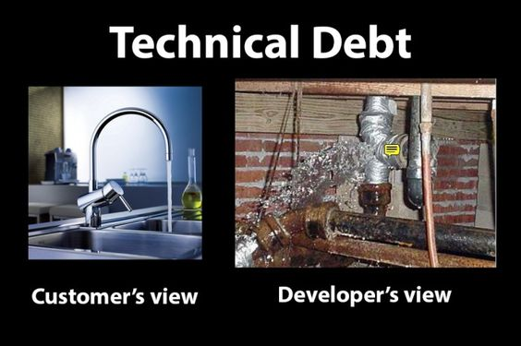
Obstacles
Low concern
Often the process of specifying requirements is seen as the full responsibility of the developer.
There is a gap
Language limitations that customers and developers understand.
Endless demands
The customer's understanding of the system develops in accordance with the development of the system requirements identified by the customer.
Allocation of resources based on an initial understanding of system requirements.

Slide 18
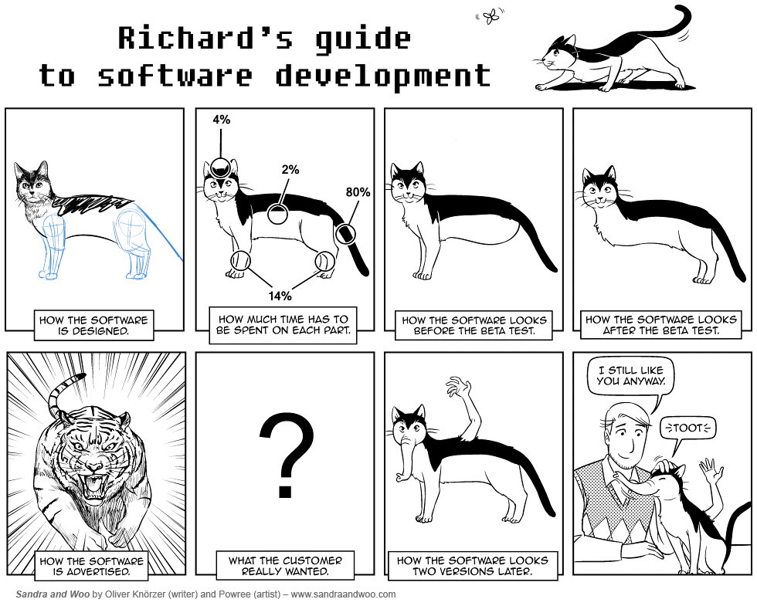

Slide 19
Software Life Cycle (SLC)
Feasible
Feasibility study
Requirement Change
Not Feasible
Requirement Engineering
Maintenance
not compatible
Design
Implementation
Operation
Software Operation Life Cycle
Testing
Release
Software Development Life Cycle
Notes:
-Development Environment: Lingkungan yg digunakan dalam proses daur hidup pengembangan PL, baik dari sistem yg sudah ada maupun dari awal.

Slide 20
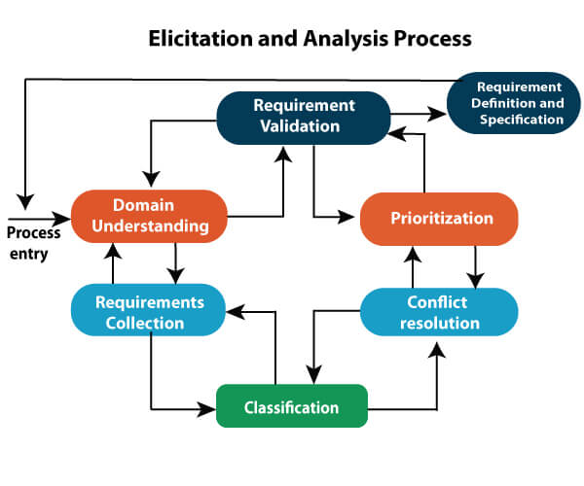
Main Activities in RE

Slide 21
Problem Domain in Software Development
CUSTOMER
BRIDGE
PRODUCT
Customer Objectives
Abstract Solution
Requirement Specification
Conceptual
Realization
What
How
What
How

Slide 22
Referensi
Daniel Siahaan, Analisis Kebutuhan dalam Rekayasa Perangkat Lunak, Penerbit Andi, 2011
Lawrence Chung, Lecture Notes of Requirements Engineering, UT Dallas, http://www.utdallas.edu/~chung/RE/Introduction.pdf
P. Laoucopoulos and V. Karakostas, Requirements Engineering: From System Goals to UML Models to Software Specifications, John Wiley Sons.

Slide 23
TERIMA KASIH

